Slide 1
Learning Informatica Cloud Data Quality (CDQ)
Authors:
Ruchi Khullar
Aiswarya Nair
Rushabh Aher
Abhishek Sanap
Lakshmi Dileep
Sam Mathew
Nagendra B
Saloni Shyam

Slide 2
About The Tool
Key Features
CLAIRE Engine – AI
Informatica Cloud Architecture
CDQ vs IDQ
Use Case
CDQ User Roles and Responsibilities
Informatica CDQ Roles and Privileges
IICS Connectors and Connections
File Source Connections
DQ Assets
Data Profiling
Exception Management
Schedule and Monitor Profiles
Scorecards
Data Quality Assets
Cleanse Asset
Dictionary Asset
Verifier Asset
Deduplication Asset
Labeler Asset
Parser Asset
Data Integration Service
External Training Links and Learning Content
CDQ Assignments
Agenda
4/17/2023
2

Slide 3


About the Tool
Informatica Cloud Data Quality empowers your company to take a holistic approach to managing data quality to quickly identify, fix, and monitor data quality problems on cloud and on-premises business applications.
This creates a true data-driven environment that accelerates cloud benefits through faster migrations and gains more trusted insights from cloud data warehouses, data lakes, and SaaS applications.
3

Slide 4
Key Features
Self-Service Data Quality for Business Users
Pre-built rules and accelerators
Integrate data cleansing and standardization, address verification, parsing, de-duplicate and enrichment capabilities.
Rich Set of Data Quality Transformations and Universal Connectivity
AI-driven insights via The CLAIRE™ engine

Slide 5
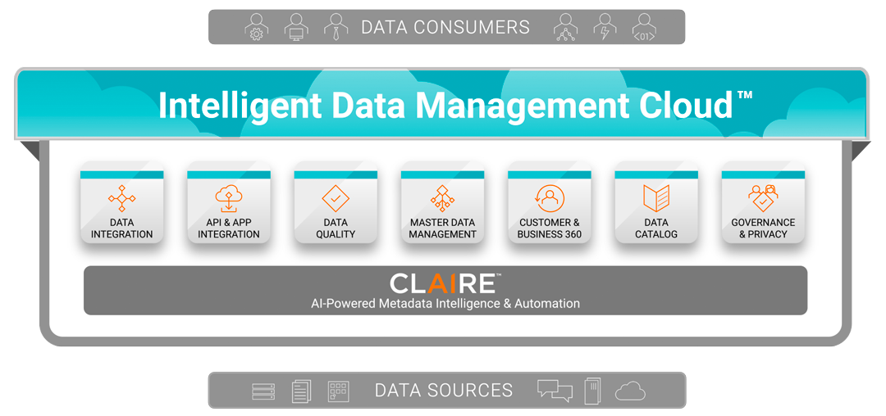
Informatica Intelligent Data Management Cloud

Slide 6
CLAIRE Engine
CLAIRE, Informatica's AI engine, uses machine learning to make recommendations across IICS organizations.
Recommends transformation types to include in the mapping.
Recommends additional sources based on primary key and foreign key relationships.
Generates Simple DQ rules based on NLP
Recommends mapplets or user-defined functions.
Recommend rule specifications and standardization.

Slide 7
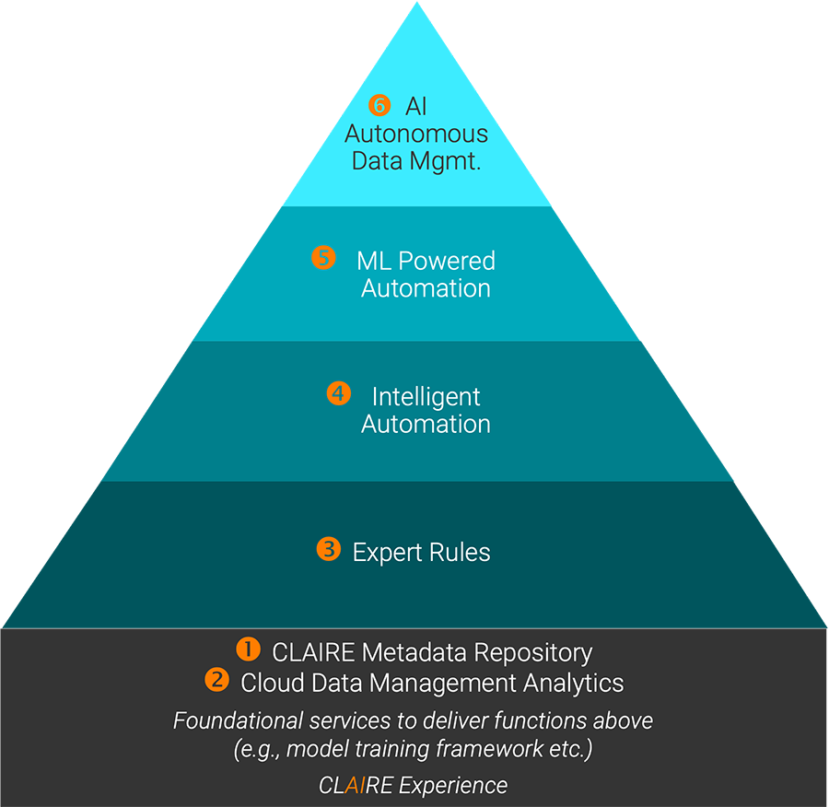
CLAIRE provides you with data observability, self-tuning, self-healing, smart scheduling, built-in orchestration and automated resource allocation.

Slide 8
Key differences between CDQ and IDQ
IDQ
On premise tool
IDQ has the IDQ Developer which has functions of data quality, data integration and profiling and Analyst tool which has the functions like Scorecarding
Many features of IDQ are combined in CDQ - like match & consolidate is combined as Dedup
Much more features than cloud-based tool as the cloud version is comparatively new.
IICS – Informatica Intelligent Cloud services
Cloud based tool
Functions are separated to Data quality (CDQ), Data integration (CDI), Data Governance and Data Profiling
All features in IDQ are still not available in CDQ and CDI, many features are still getting upgraded
Easier to use than IDQ – features like smart map
Lower cost of upgradation, updating patches etc.
Higher levels of authentication and security e.g MFA

Slide 9
Why one should opt for CDQ over IDQ:
Cloud hosted
Easy connectivity with cloud systems/on premise systems
Licenses based on IPU i.e processing units used
Can be accessed anywhere over the weblink
Concept of elastic mappings available so mappings can adjust for data volume/data processing units.
Features like Mass data ingestion, Data synchronization tasks available that might be useful for implementing data quality for cloud data migration projects.
Data deduplication is simpler based on fuzzy match as have deduplication transform that not available in IDQ.

Slide 10
Use case: DQ for data migration
Details:
Organization XYZ is planning to migrate data from On premise/Legacy Applications to cloud hosted DB. During the data migration process, organization wants to check the DQ standards and various attributes meeting target design/values.
Implementation:
Informatica Cloud data quality would be a better option here as DQ setups is required just for data migration purpose so cloud platform would avoid any infrastructure related setup to be done by the organization.
DQ statistics can be checked by first creating data profiles on various data extracts received from legacy applications.
Data validation rules can be setup as rule specifications in CDQ and added on profiles to analyze the attribute values and to avoid any failures during target data load.

Slide 11
Roles and responsibilities of Users
CDQ Steward:
To keep a check on overall data quality health and take go/no-go decisions based on DQ results. Make roadmap to fix known DQ issues and to design a framework to maintain good DQ score in future. Report known data issues to business so that a permanent solution can be implemented on organization level.
CDQ Analyst:
Analyze deeply the DQ results and work with development teams to help setup required business rules to check data quality and to setup required data cleansing rules as per known data quality issues.
CDQ developer:
Work with Data Analysts to implement DQ validation/cleansing processes in system and timely report identified DQ issues to Data teams.

Slide 12
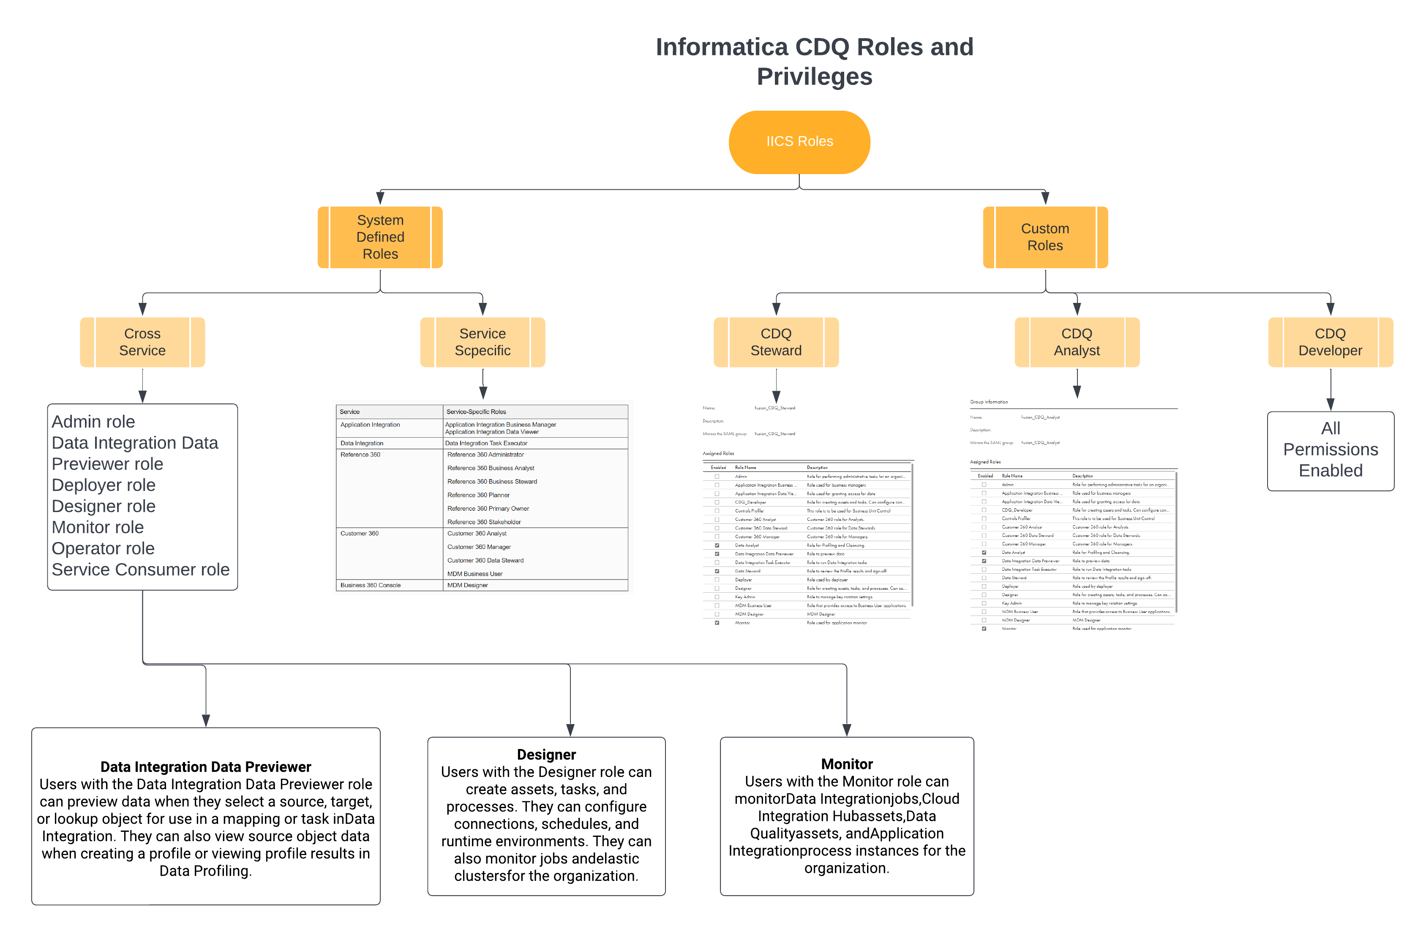
Informatica CDQ Roles and Privileges

Slide 13
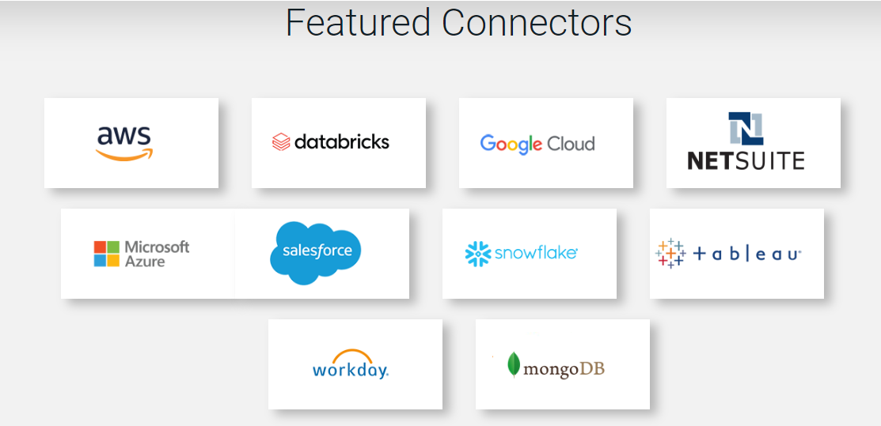
Connectors and connections
Connections provide access to data in cloud and on-premise applications, platforms, databases, and flat files.
A connection can be created for connectors that are installed in Informatica Intelligent Cloud Services.
Refer Connectors_IICS.xlsx for the list of connectors provided by IICS.
13

Slide 14

File Sources Connections
File sources include flat files and FTP/SFTP files.
We can configure a file source by specifying the connection, source type, and formatting options
For a delimited flat file type configuration can be done as follows:
Delimiter: Delimiter character can be a comma, tab character, colon, semicolon, nonprintable control character, or a single-byte or multibyte character.
Text Qualifier: Character to qualify text.
Escape character
Field labels: Determines if the task generates field labels or imports labels from the source file.
First data row: The first row of data. The task starts the read at the row number that you enter.
For a fixed-width flat file type, select the fixed-width file format to use.
List of connectors available:

Slide 15
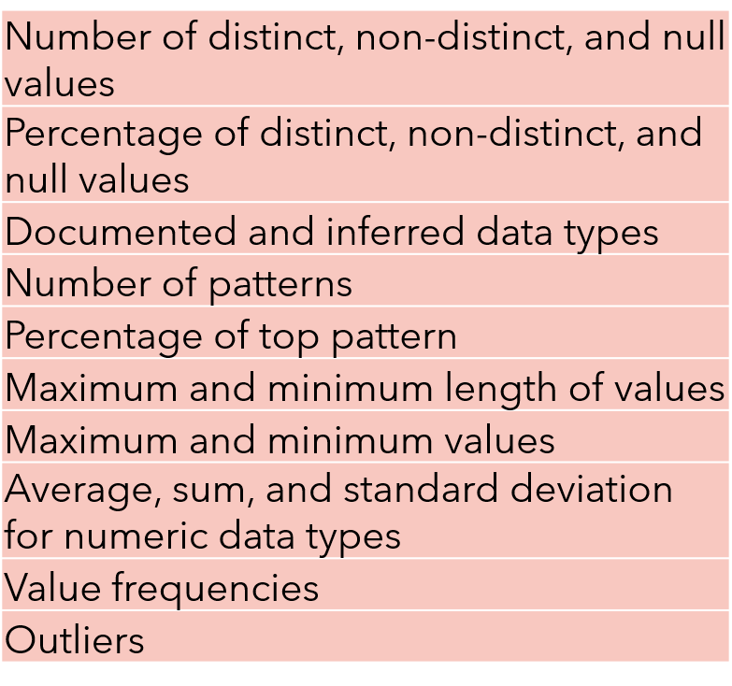
Data Profiling
Use Data Profiling to create and run data
profiling tasks/profiles.
Data profiling tasks can be run on relational
data sources and flat file data sources.
For file sources, header formatting options are
available
The resultant column statistics includes
Apart from statistics, trends in data, Unique values,
frequency value distributions, insights can also be
inferred.
Can compare the results for two profile runs to analyze
and compare the content and statistics.
15

Slide 16
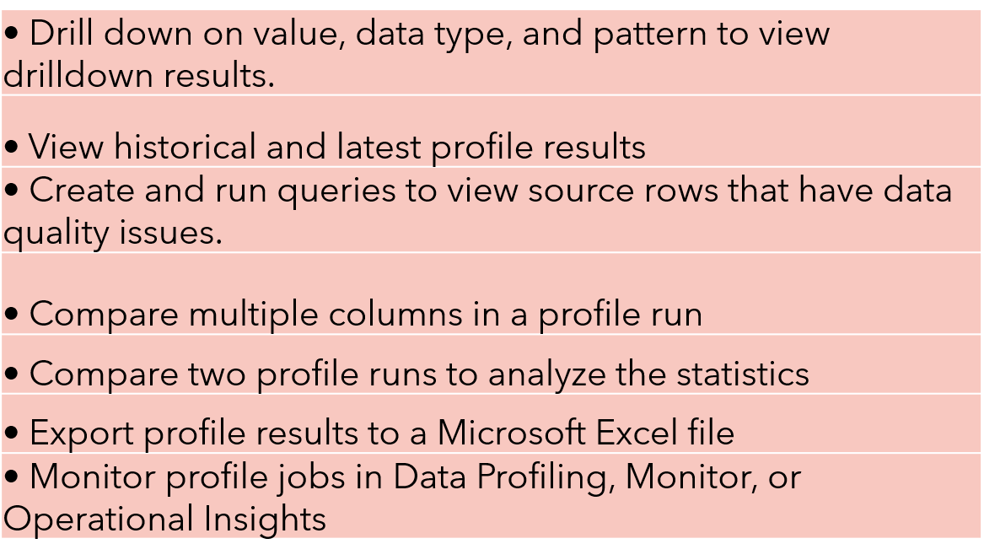
Profiling Contd…
After a profile run, the following actions can be performed:
We can edit column metadata, apply filters and preview data before we run a profile.

Slide 17

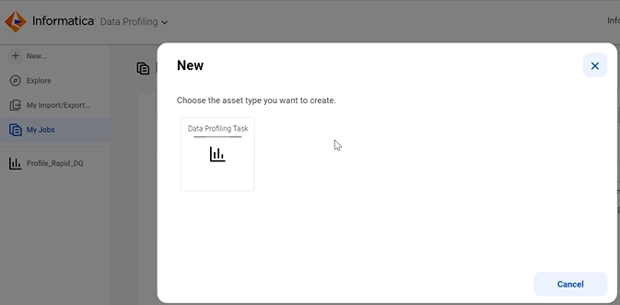
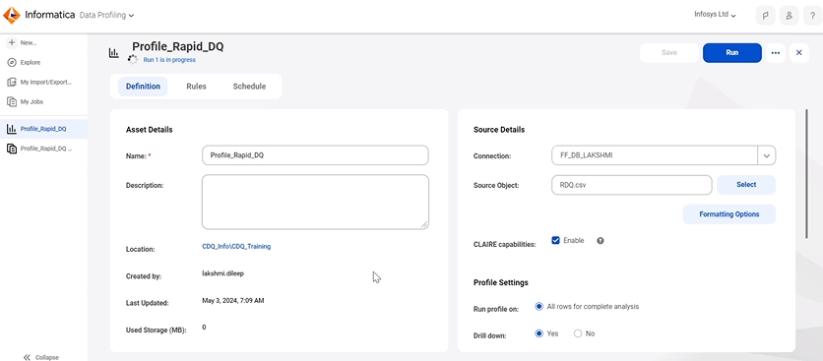
Data Discovery: Profile Creation
Data Steward
A profile is an asset that an analyst can create to discover the content, quality, and structure of a data source.
Steps:
1. Select ‘New’ and click on ‘Data Profiling Task’ to create new profile.
2. In next screen, provide name & location to save the profile.
3. Select source connection and object details.
4. Filter can be added if required to filter the data before profiling.
5. Data preview can be done before profiling.

Slide 18
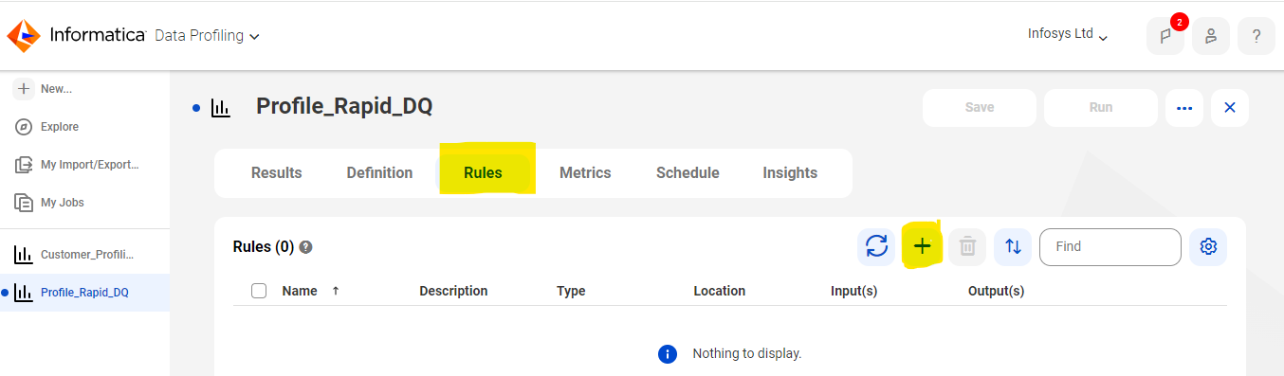
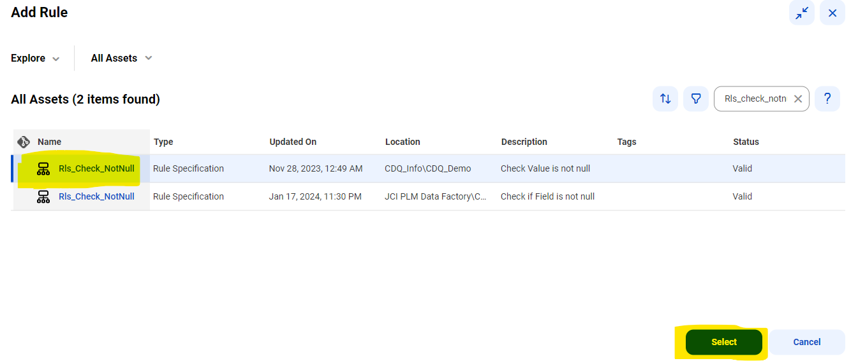
Data Discovery: Profile Creation (Contd.)
Data Steward
1. Add any validation/cleansing rules to the profile to view the results.

Slide 19
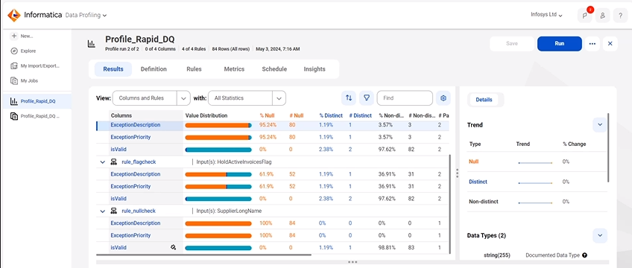
Data Discovery: Profile Creation (Contd.)
Data Steward
2. Save and Run the profile.
3. Data Analyst/ Data Steward can analyze the profile results in results tab once profile job is run.

Slide 20
Exception Management
Exception management is done to identify exception/error records in your data and analyze it
The Following actions can be done to create and exception task and handle exceptions
Create rule and add the exception message for the invalid records.
Create and run the profile with the rule.
Create an exception task with the specific rule and run it.
Download the exception data.

Slide 21
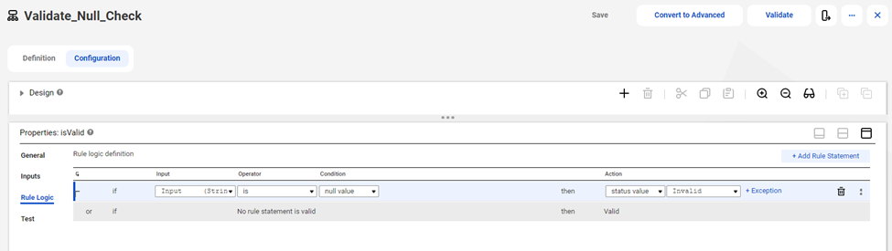
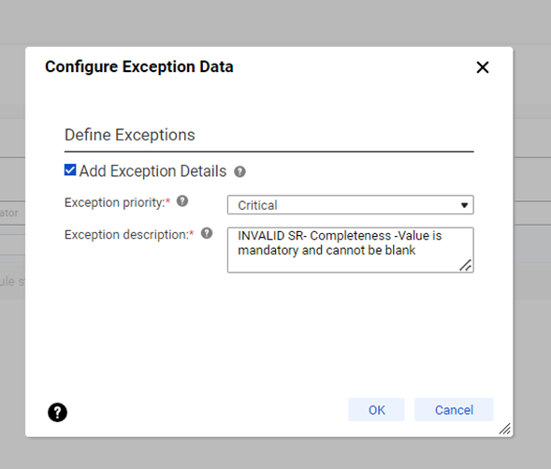
Exception Management: Rule Creation
Data Steward
Create rule with rule set name as 'isValid'
Add the appropriate exception message .
Add the exception priority (Critical, Major, Minor) depending on the requirement

Slide 22
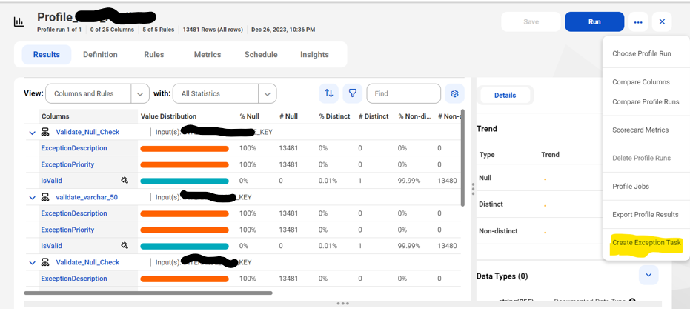
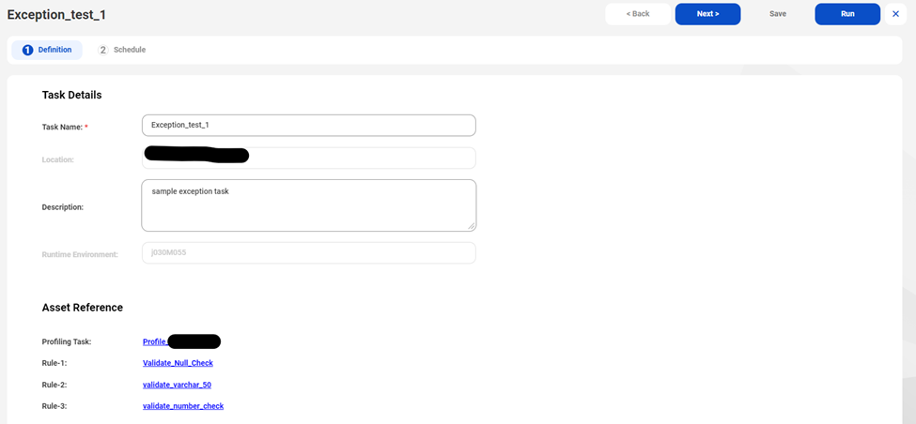
Exception Management: Task Creation
Data Steward
Create the exception task and run it. Download the exception file to analyze the errors

Slide 23
Schedule and Monitor Profiles
The Following actions can be done to schedule/monitor profiles:
Choose a schedule to run the data profiling task. You can create, view, edit, and delete schedules in Administrator.
After you run a profile on a source object, you can create and run one or more queries on the source object.
Choose a runtime environment or run profiles in default environment.
Choose to send email notifications based on the profile job status-> warning, failure, and success with default/custom message.
Configure the session options to specify the number of non-fatal errors the data profiling tasks can encounter before Data Profiling stops the session

Slide 24
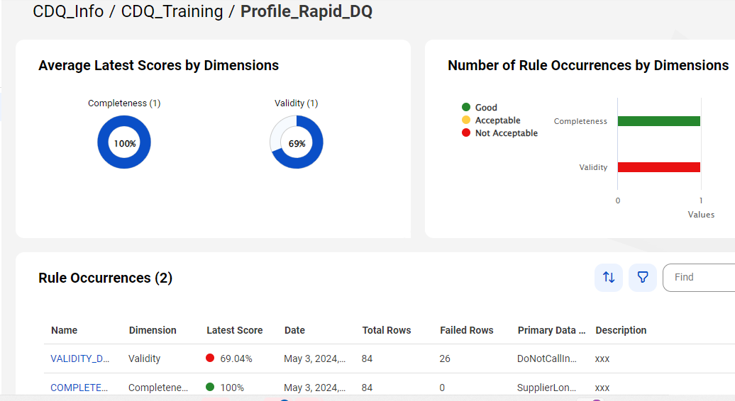
Scorecards
Prerequisites to view the scorecard dashboard in Data Governance and Catalog:
→Must have Intelligent Cloud Data Management and Data Governance and Catalog licenses.
→User must be assigned the Governance User role​.
Use scorecards to measure data quality scores and monitor data quality progress for existing and new profiles.

Slide 25
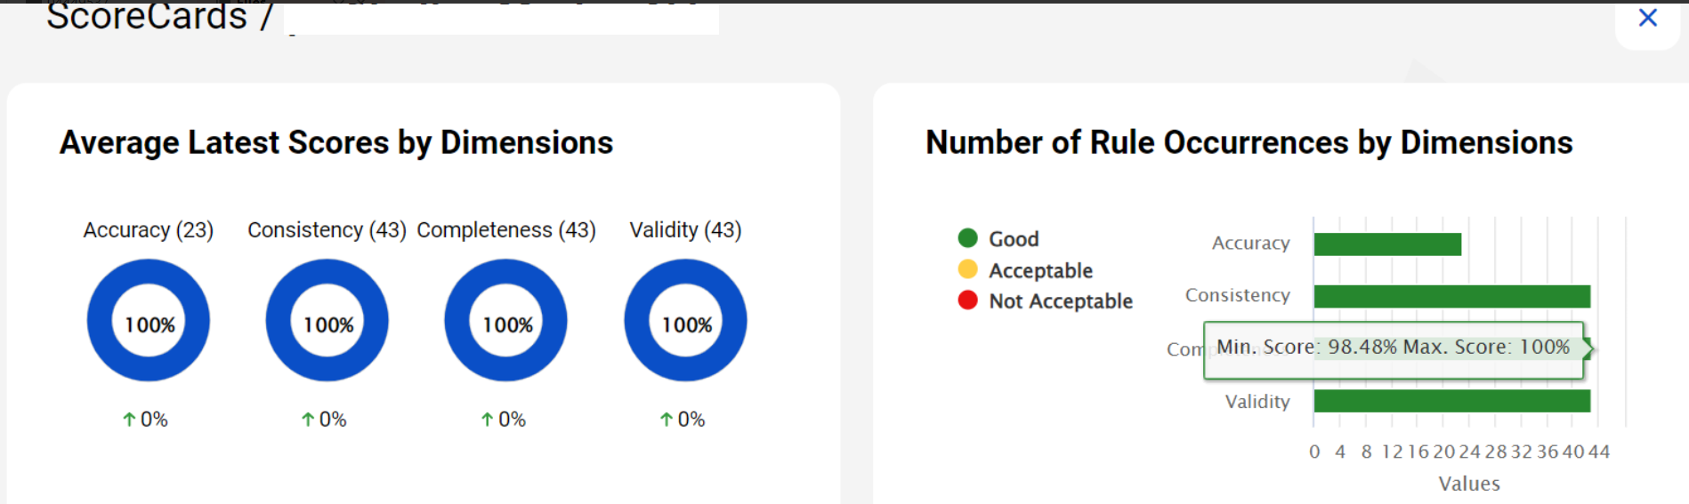
Features Of Scorecards
Donut charts with round off values of the average latest data quality scores based on dimensions.
Number of rule occurrences for each dimension based on Good, Acceptable, and Not Acceptable threshold values.
Shows the following details of rule occurrences:
Latest data quality score
Rule specification Dimension
Date and time of latest profile run
Total number of rows processed
Total number of failed rows
Input column or primary data element
Successful and unsuccessful rows’ preview

Slide 26
Data Quality Rules
DQ rules calculate the quality of data based on a predefined aggregation path and metrics.
On the Rules tab, you can add Data Quality assets as rules to a profile.
Rules can be assigned automatically to the profile based on the chosen source object and its attributes.
One or more rules can be applied for a profile run.
A rule specification is a reusable object.
A rule specification is a read-only object in Data Integration. The rule specification does not change unless you update it in Data Quality.

Slide 27
DQ Dimensions
Dimension | How it’s measured
Accuracy | How well does a piece of information reflect reality?
Completeness | Does it fulfill users’ expectations as to how fully it represents the truth?
Consistency | Does information stored in one place match relevant data stored elsewhere?
Timeliness | Is your information available when users need it?
Validity | Is information in a specific format, does it follow business rules, or is it in an unusable format?
Uniqueness | Is this the only instance in which this information appears in the database?

Slide 28
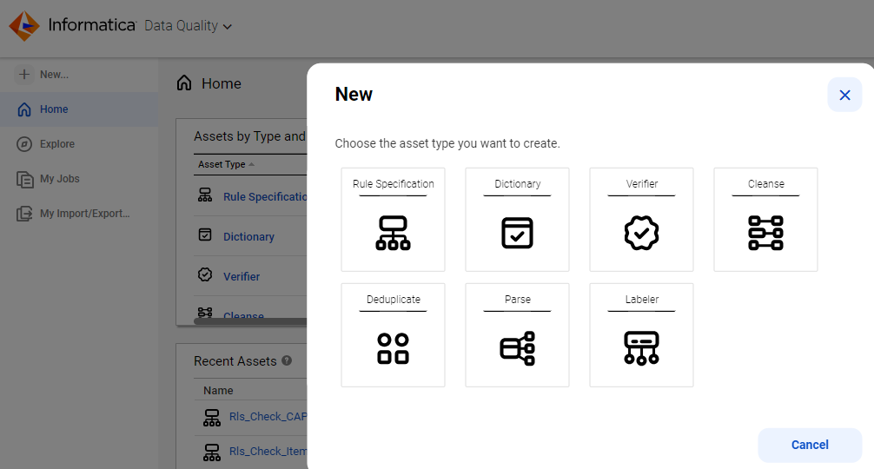
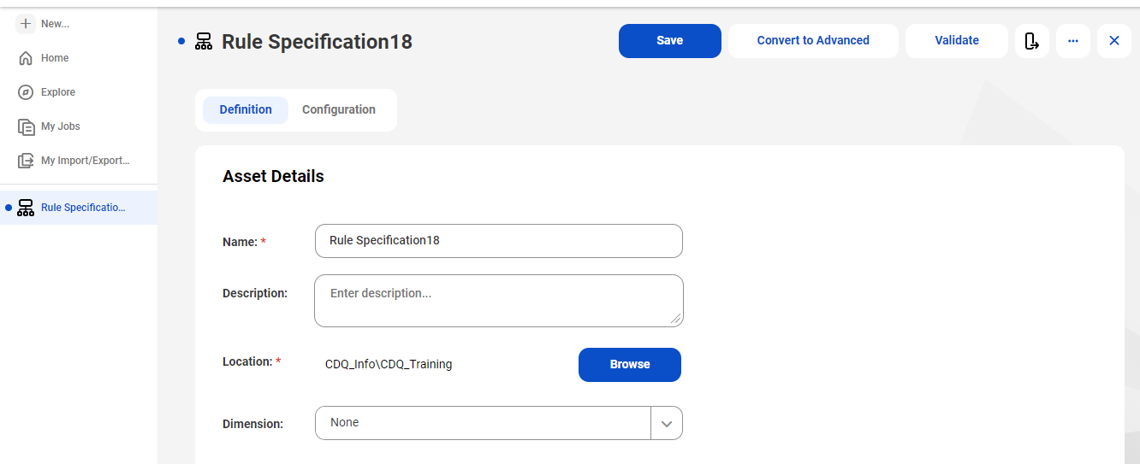
Design Business Logic: Rule/Rule Specification Creation
Creating a rule:
1. Click on ‘New’ and click on ‘Rule Specification’.
Create rule either based on ‘Functions’ or based on
‘Columns’ in the window which pops up next. Once expression
2. Give name to rule specification and location to be saved in.

Slide 29
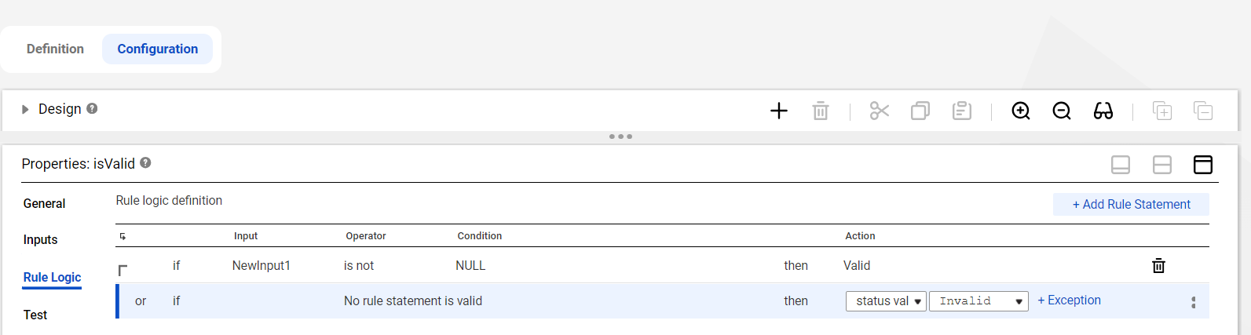
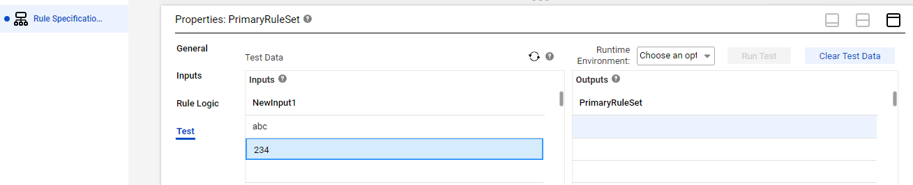
Design Business Logic: Rule/Rule Specification Creation (Contd.)
3. Configure the rule definition:
4. Test the rule in test tab:

Slide 30
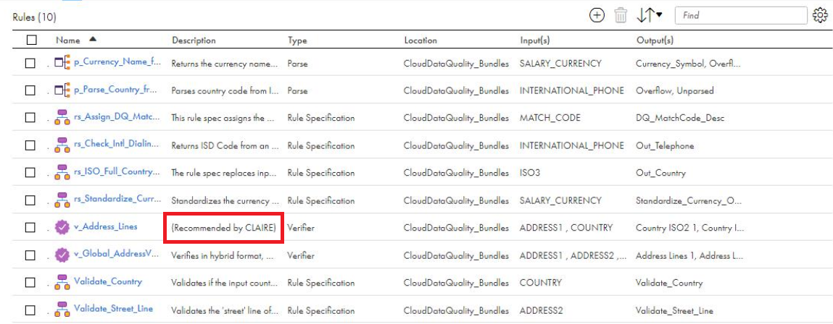
Automatic rule association with source objects
Data Profiling automatically associates DQ assets as rules with columns
Based on the column and source object name match.
It associates rules with columns of Oracle, Flat File, ODBC, and Amazon S3 V2 connections.
To enable automatic rule association, it is necessary to have a valid DataQualityClairRule package license.
The DataQualityClaireRule package contains the connection-specific JSON files and a default JSON file.
Configure JSON files to enable automatic rules.

Slide 31
Data Quality Assets
Cleanse: Standardize the appearance of your data
Verifier: Measure and enhance the quality of your postal address data
Parse: Improve the structure of your data.
Labeler: Mask sensitive data.
Deduplicate: Remove duplicates from data
Dictionary: Reference for standard data values
Rule Specifications: Function/expressions to check validity

Slide 32
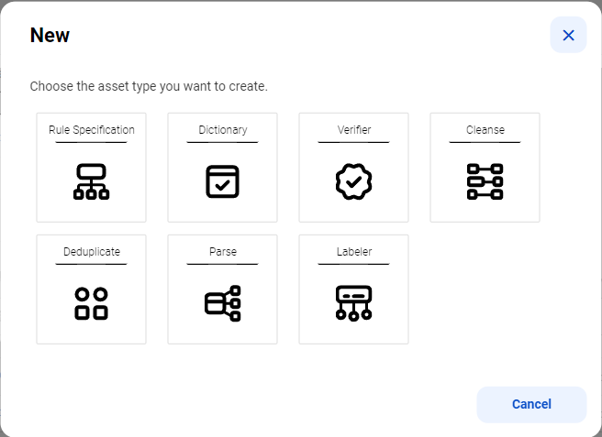
Snapshot of DQ assets

Slide 33
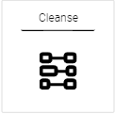
Cleanse
Data Cleansing
- Cleanse Data: Remove noise (Convert Case | Remove Values + Spaces | Replace Values) from fields
- Standardize Data: correct completeness, conformity and consistency issues
Cleanse Asset
- Case Converter Transformation: creates data uniformity by standardizing the case of (input) string
- Standardizer Transformation: standardizes characters/strings using dictionaries, replace custom text and remove dictionary table matches

Slide 34
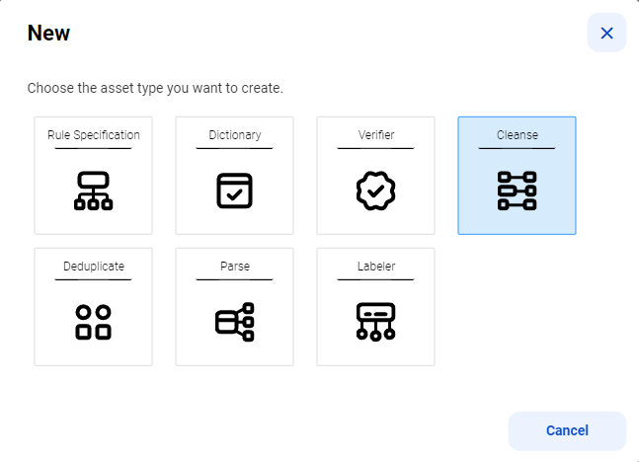
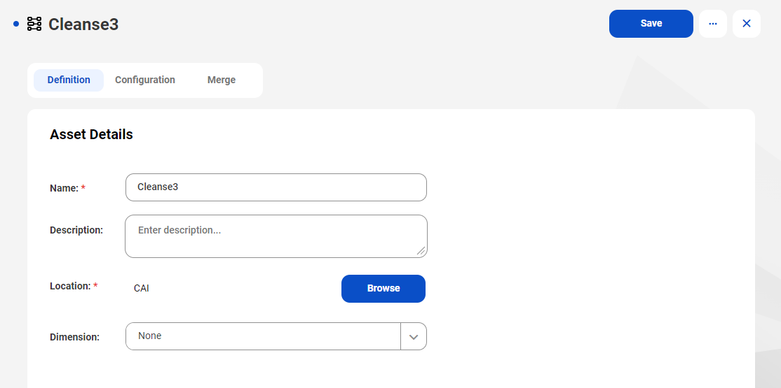
Design Business Logic: Cleanse Creation
Creating Cleanse rule:
1. Click on ‘New’ and click on ‘Cleanse’.
2. Give name to Cleanse and location to be saved in.

Slide 35
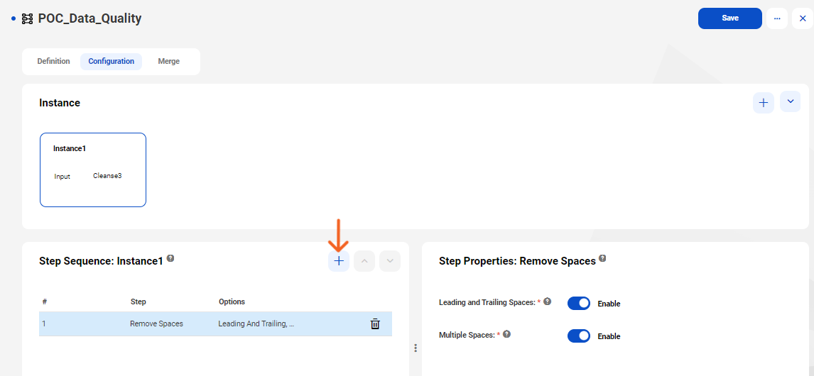
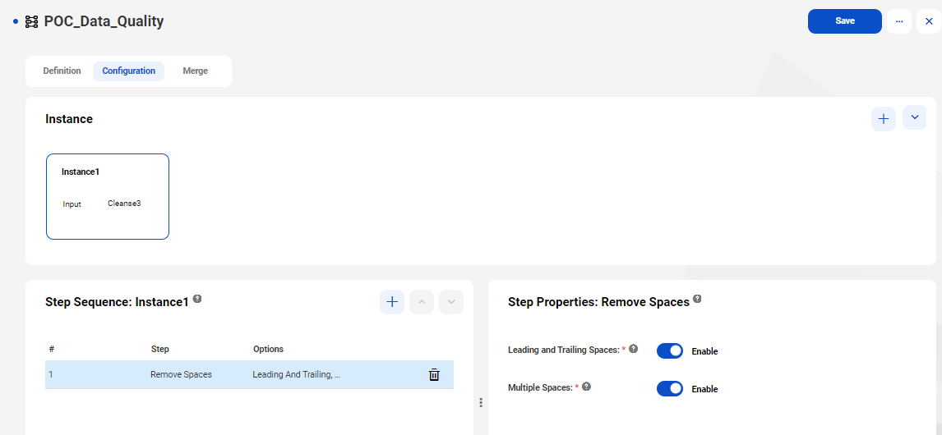
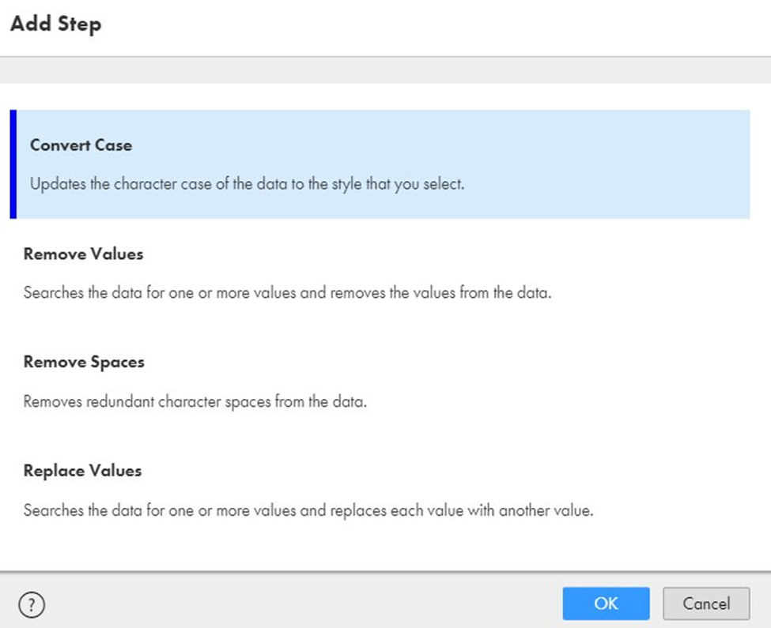
Design Business Logic:
Cleanse Creation 1) When we create a cleanse asset, the Instance panel in the Configuration view displays a single default cleanse instance. The input field name is the name of the asset. Optionally, you can add input fields and modify the default input field name and instance name. 2) click on plus symbol in Step Sequence: and Select one of the following step types:
Convert Case :- Updates the character case of the data in an input field.
Remove Values:- Searches an input field for one or more values that you specify and removes the values.
Remove Spaces:- Removes redundant character spaces from an input field.
Replace Values:- Searches an input field for one or more values that you specify and replaces the values. 3) Step Properties : To enable Leading and Trailing Spaces and Multiple Spaces.

Slide 36
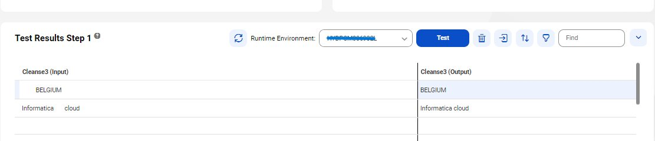
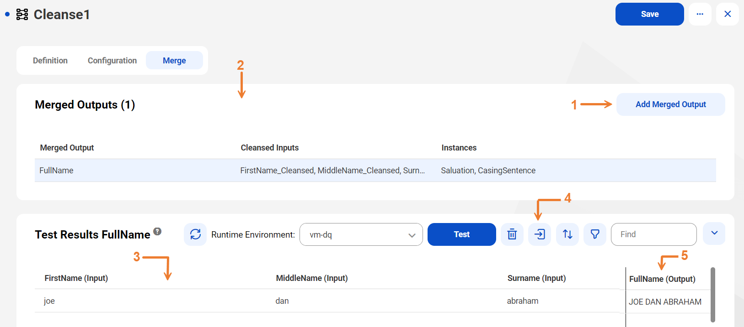
Design Business Logic: Cleanse Creation(Contd.)
Test Results:-
Contains the result of the test for the instance that you select. The asset displays an output field for each input field that you add to an instance.
Merge:-
Use the Merge tab options to merge multiple input fields into a single output field. You can merge any combination of the fields to suit your data requirements.
Configure it and click on test.
Save the asset.
Notes:
.

Slide 37
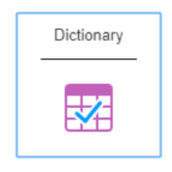
Dictionary
Reference data object that you can use in a data quality asset to verify and enhance the accuracy and usability of your data.
Dictionaries can be used to identify, validate and standardize data as part of Rule Specifications.

Slide 38
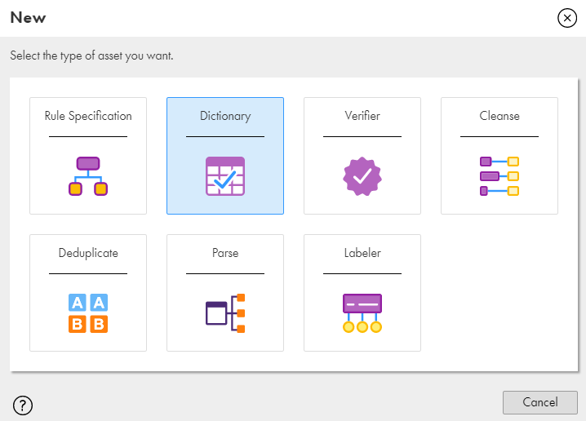
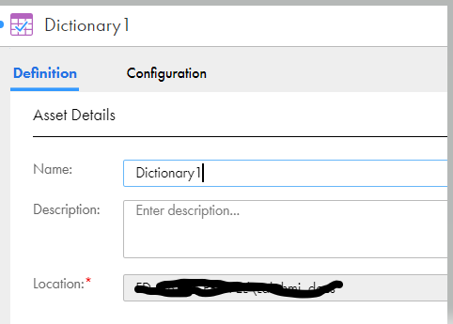
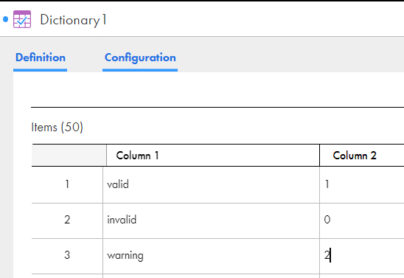
Design Business Logic: Dictionary Creation
Creating Dictionary:
1. Click on ‘New’ and click on ‘Dictionary’.
2. Give name to dictionary and location to be saved in, then add the values to the dictionary

Slide 39
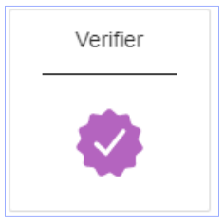
Verifier
Address Verification
- Verify and correct address from over 240 countries and territories
- Standardize and format addresses according to country specific rules
- Get status codes to measure your address quality
Geo coding
- Append geo coordinates for addresses in over 200 countries
- Precise arrival point geo codes available in over 50 countries

Slide 40
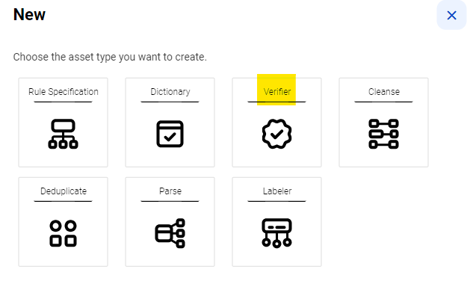
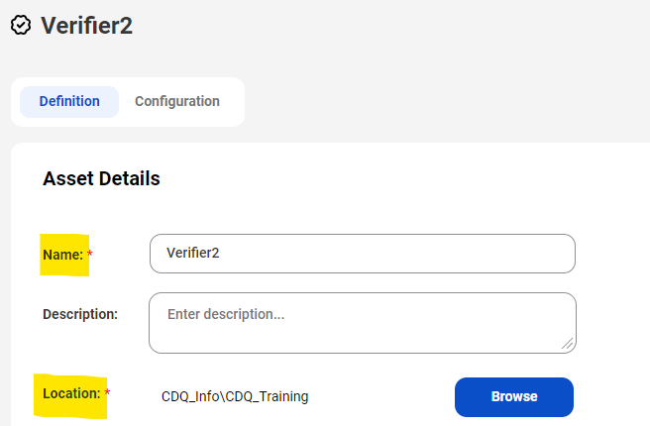
Design Business Logic: Address Verifier Creation
Creating address verifier:
1. Click on ‘New’ and click on ‘address verifier’.
2. Choose appropriate configuration from discrete, hybrid, multiline
3. Give name to rule specification and location to be saved in.

Slide 41
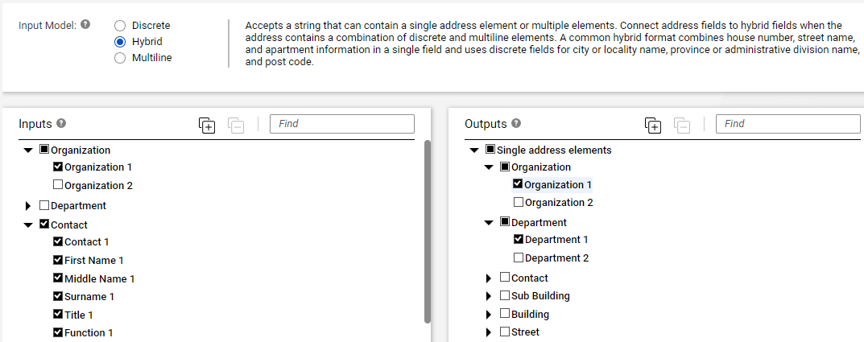
Design Business Logic: Address verifier Creation (Contd.)
Data Steward
4. Configure the input and output values as per requirement:
Notes:
.

Slide 42
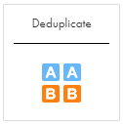
Deduplication
Analyze the levels of duplication in a data set
Consolidate sets of duplicate records into a single, preferred record.

Slide 43
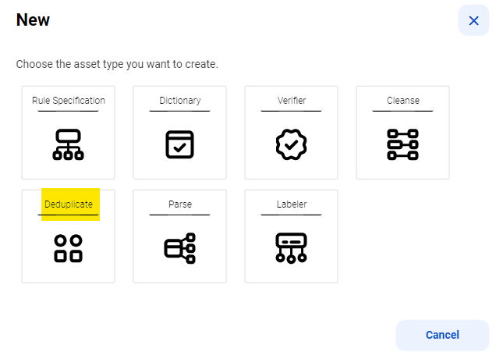
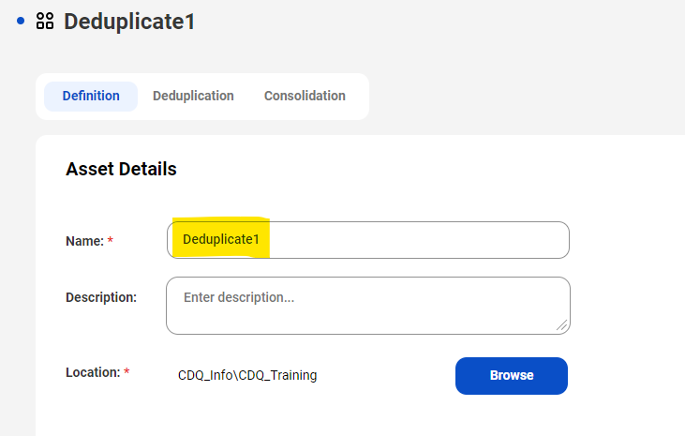
Design Business Logic: Dedup Creation
Creating a dedup:
1. Click on ‘New’ and click on ‘Dedup’.
2. Give name to rule specification and location to be saved in.

Slide 44
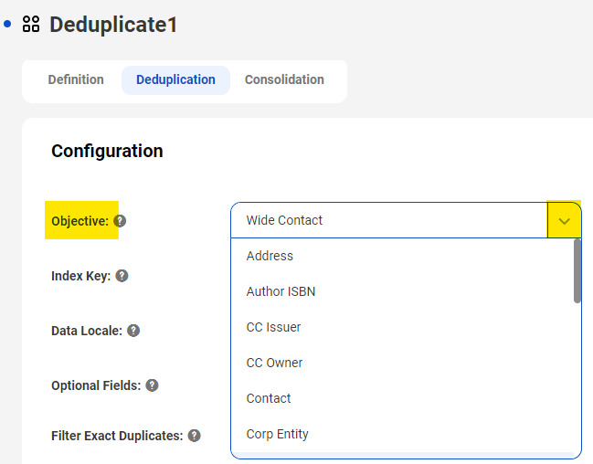
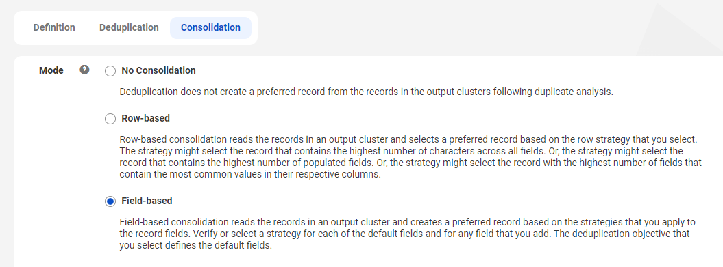
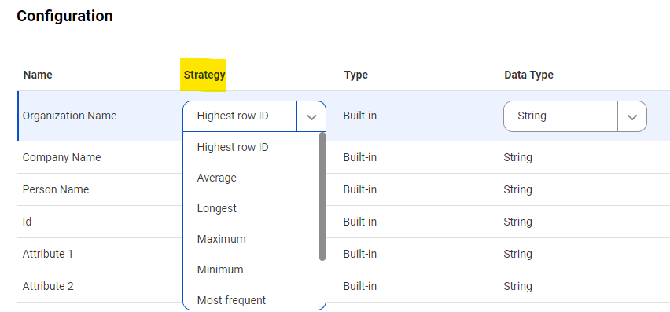
Design Business Logic: Dedup Creation (Contd.)
Data Steward
3. Choose the right objective from the drop-down list 4. Choose the consolidation method and assign strategy
Notes:
.

Slide 45
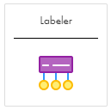
Labeler
Perform token labeling or character labeling.
Token labeling analyzes one or more tokens, or delimited values, in an input field.
Character labeling analyzes the individual characters in the input field.
This asset writes a label for each type that it identifies to a corresponding output field.

Slide 46
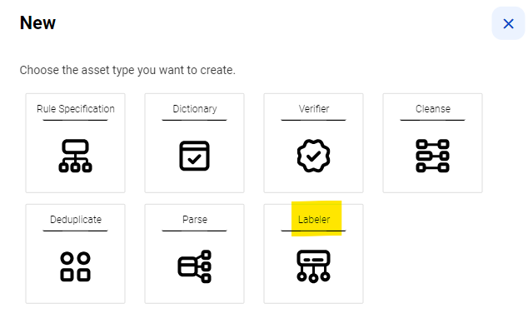
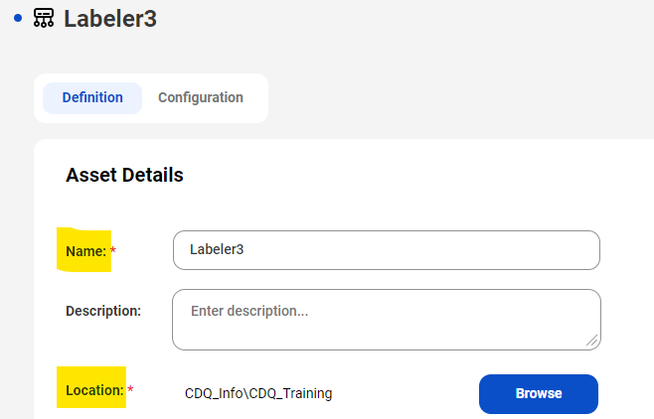
Design Business Logic: Labeler Creation
Creating a labeler:
1. Click on ‘New’ and click on ‘Labeler’.
2. Specify token or character labeler
3. Give name to rule specification and location to be saved in.

Slide 47
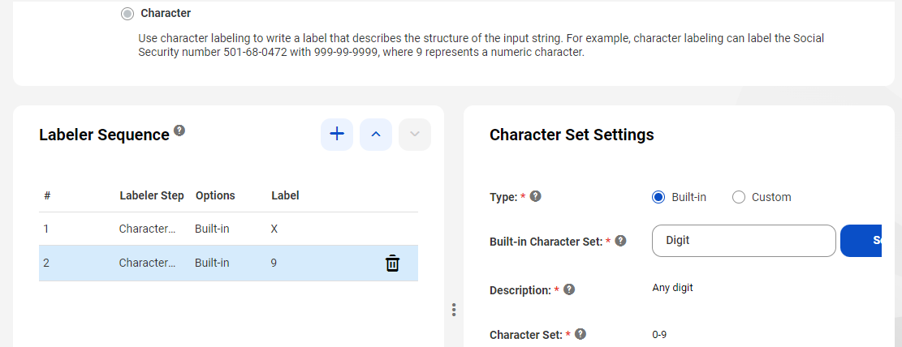
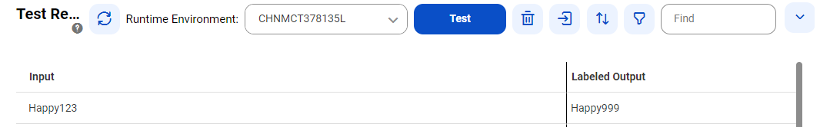

Design Business Logic: Labeler Creation (Contd.)
4. Configure the labeler:
5. Test the labeler in test tab:
Notes:
.

Slide 48

Parser
Use a parse asset to improve the structure of your data.
Defines a set of operations that can identify discrete values in an input field and write the values to appropriate output fields.

Slide 49


Design Business Logic: Parser Creation
Creating a parser:
1. Click on ‘New’ and click on ‘Parser’.
2. Specify custom or prebuilt parser
3. Give name to parser and location to be saved in.

Slide 50



Design Business Logic: Parser Creation (Contd.)
4. Configure the parser:
5. Test the parser in test tab:
Notes:
.

Slide 51

Data Integration - MAPPING
A mapping defines reusable data flow logic that you can use in mapping tasks.
Used for specific ordering of logic or joining sources from different systems.
Add transformations to transform data, such as an Expression transformation or a Filter transformation.
Components such as mapplets, business services, and hierarchical schema definitions can be used in mappings.

Slide 52
Setting Up IICS Lab Instance User Guide
Please click on the icon below and follow the instructions for setting up your IICS lab-instance.

Slide 53
External Training Links and Learning Content:
Lex Courses:
1. Data Integration Using Informatica Intelligent Cloud Services(IICS)
TOC - Data Integration Using Informatica Intelligent Cloud Services(IICS) | Lex (infosysapps.com)
2. Informatica (Transformation)
TOC - Informatica (Transformation) | Lex (infosysapps.com)
3. Dimensions of Data Quality and Data Quality Improvement
TOC - Dimensions of Data Quality and Data Quality Improvement | Lex (infosysapps.com)
4. Informatica Cloud Tutorial
https://svrtechnologies.com/informatica-cloud-tutorial/
5. IICS Quiz
TOC - IICS Quiz | Lex (infosysapps.com)

Slide 54
Continue…
Below are some important YouTube learning links.
1. Cloud Data Profiling:
Exploring Profile Results in Informatica Cloud Data Profiling - YouTube
Creating and Running a Profile in Informatica Cloud Data Profiling - YouTube
Creating Rule Occurrences & Viewing Scorecards - Cloud Data Profiling & Data Governance and Catalog - YouTube
2. Cloud Data Quality:
Overview of Scorecards in Cloud Data Quality - YouTube
Overview of Dictionary Asset in CDQ - YouTube
How to Create and Run Cloud Data Profiling Task in Cloud Data Quality - YouTube

Slide 55
3. Scorecards:
Data Profiling: Modes of Run - YouTube
Data Quality Scorecards - YouTube
How to Create a Data Quality Scorecard with Informatica Cloud Data Quality - YouTube

Slide 56
CDQ Assignments
Please find attached the assignment document. It includes the following tasks:
Creation of Data profile
Creation and implementation of validation rules using rule specification asset
Creation and implementation of Dictionary using Data Dictionary asset
Creation of Scorecards
Creation and implementation of CDI mapping
Best of luck with the assignment!

Slide 57
Thank You!

